Slide 1

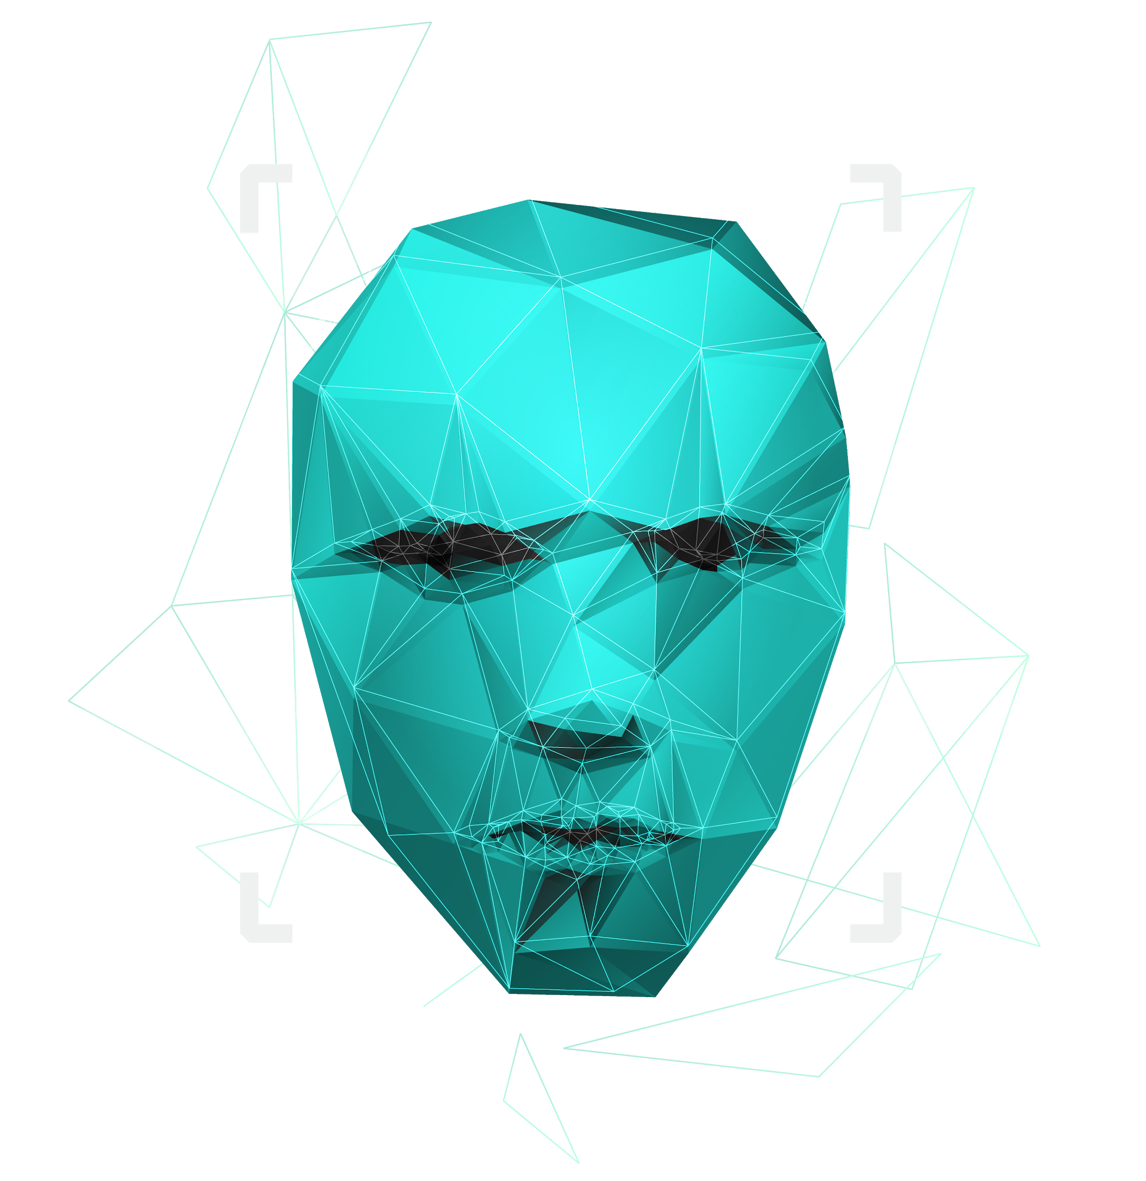
FACE RECOGNITION

Slide 2
Shambhavi Tripathi 189302174 Harshavardhan R. 189302175 Harsha Vardhan Peela 189302172
SUBMITTED BY
SUBMITTED TO
PROFESSOR D.P SHARMA

Slide 3
PROBLEM STATEMENT
IMPLEMENTATION OF FACE RECOGNITION USING PCA AND SVM

Slide 4
CONTENT
INTRODUCTION TO MACHINE LEARNING
PROJECT FLOW
LEARN MORE ABOUT PCA, SVM
CODE SNIPPETS
WHY FACIAL RECOGNITION ?
Mercury is the closest planet to the Sun and the smallest one in the Solar System—it’s only a bit larger than our Moon. The planet’s name has nothing to do with the liquid metal, since it was named after the Roman messenger god, Mercury

Slide 5
WHAT IS MACHINE LEARNING ?
Machine learning is an application of artificial intelligence (AI) that provides systems the ability to automatically learn and improve from experience without being explicitly programmed. Machine learning focuses on the development of computer programs that can access data and use it to learn for themselves.

Slide 6
PROJECT FLOW – EIGENFACE ALGORITHM 1. INITIALIZATION PROCESS 2. RECOGNITION PROCESS
6,000,000
Prepare the training faces
Prepare the data set
Compute the average face vector
Using PCA, we reduce the dimensionality of the dataset
Eigenvectors and Eigenvalues are determined

Slide 7
Read the testing face image
Show the accuracy of the model
STAGE 1
STAGE 2
STAGE 3
Find the face which shows similarity to test image using SVM classifier
Jupiter is a gas giant and the biggest planet in our Solar System

Slide 8
PACKAGES
Numpy
Seaborn
Sklearn[ ML library]
Pandas
Matplotlib

Slide 9
PCA FOR FACE RECOGNITION
PCA is a statistical approach used for reducing the number of variables in face recognition. In PCA, every image in the training set is represented as a linear combination of weighted eigenvectors called eigenfaces. These eigenvectors are obtained from covariance matrix of a training image set. The weights are found out after selecting a set of most relevant Eigenfaces. Recognition is performed by projecting a test image onto the subspace spanned by the eigenfaces
Mercury is the closest planet to the Sun and the smallest one in the Solar System—it’s only a bit larger than our Moon. The planet’s name has nothing to do with the liquid metal, since it was named after the Roman messenger god

Slide 10
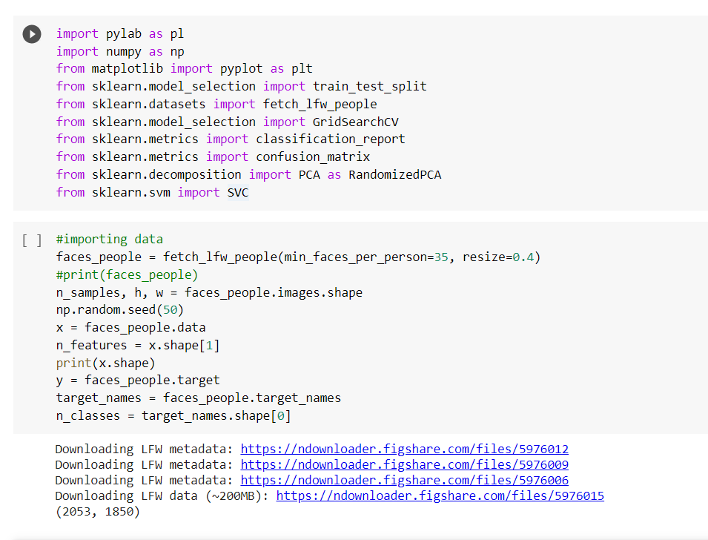

Slide 11
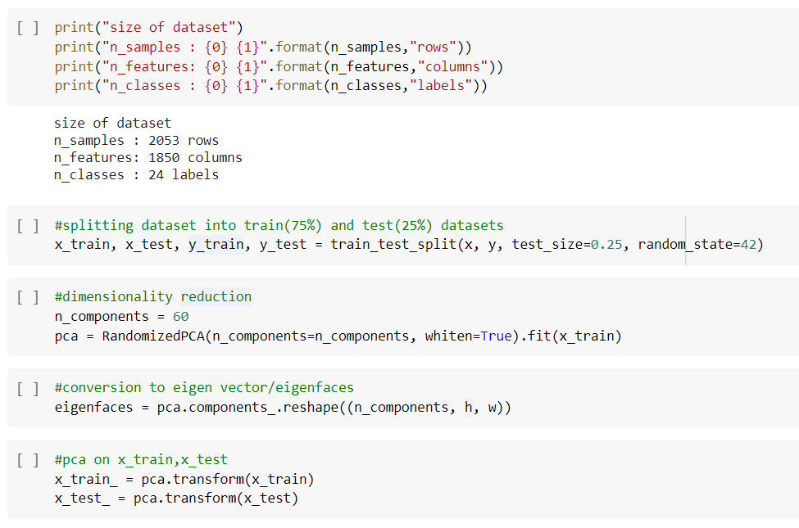

Slide 12
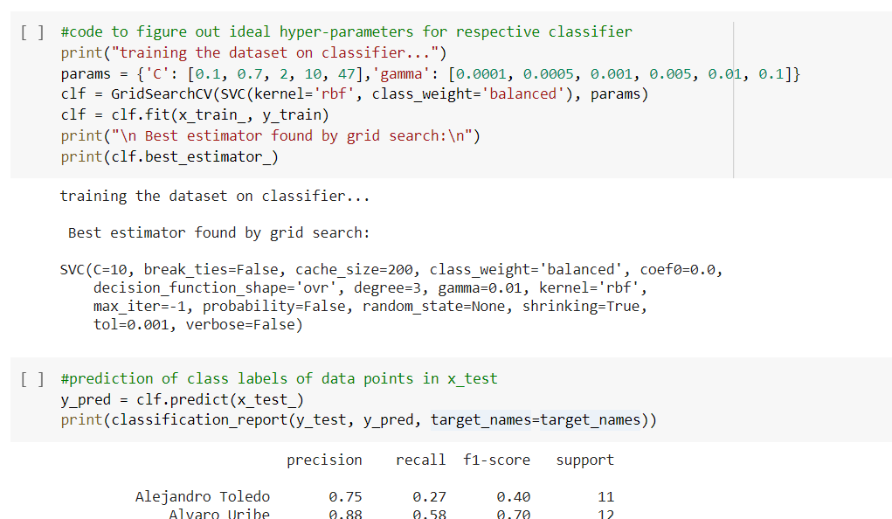

Slide 13
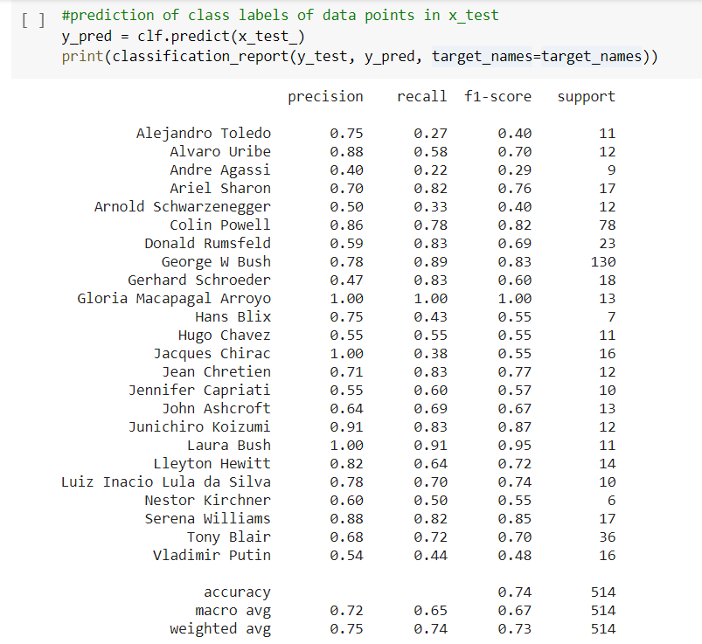

Slide 14
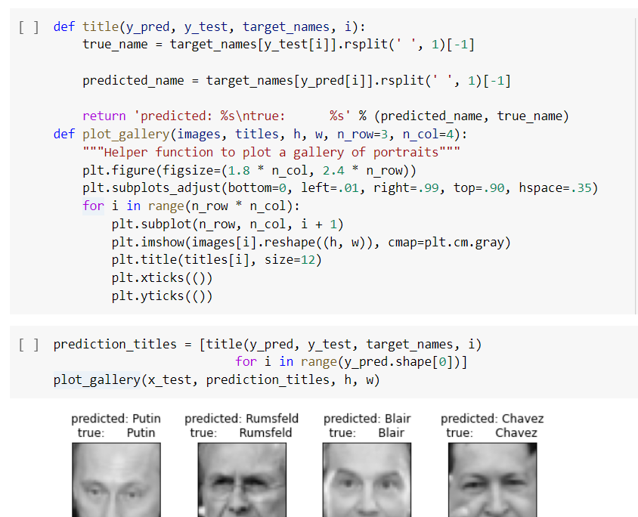

Slide 15
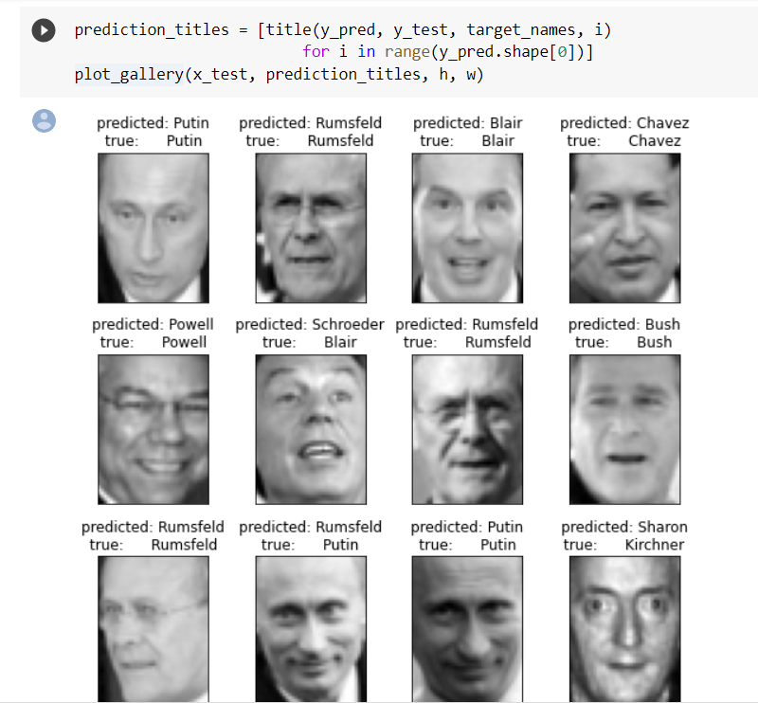

Slide 16
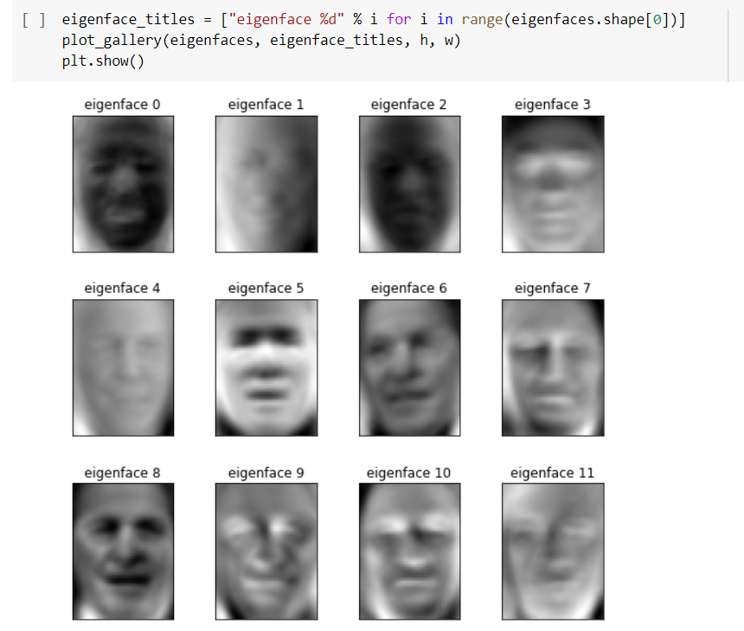

Slide 17
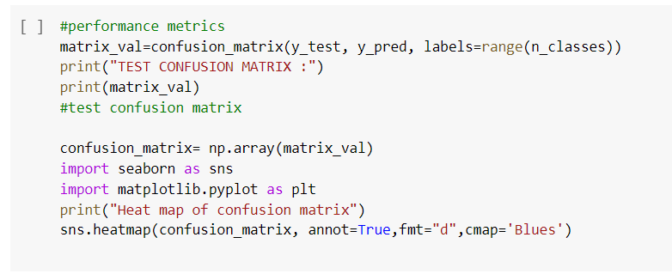

Slide 18
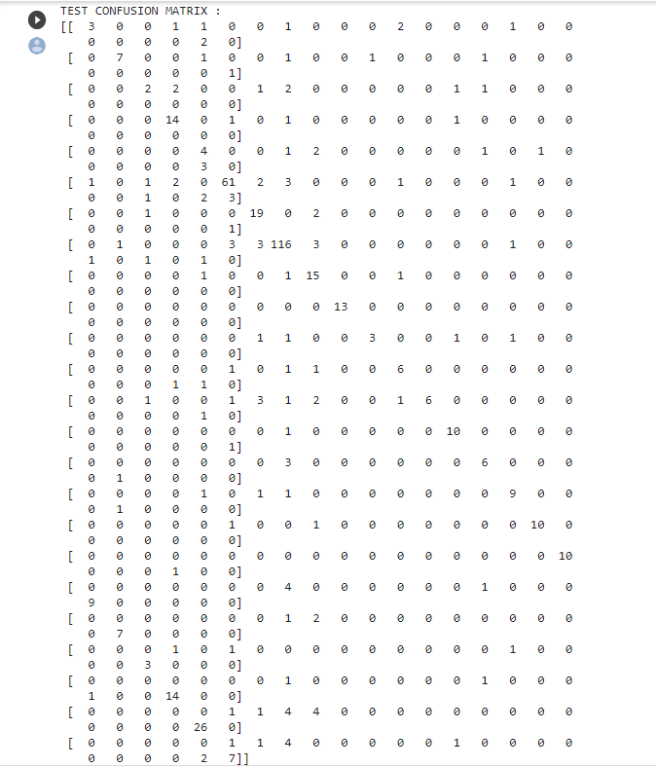

Slide 19
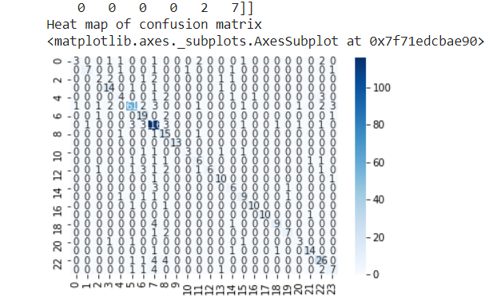

Slide 20
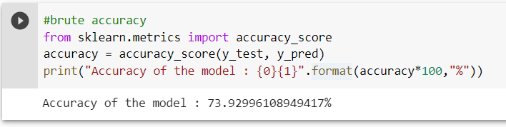

Slide 21
CONCLUSION Why Facial Recognition is Better at Biometric Verification than Fingerprint Scans
SECURE
ACCESSIBLE
FAST AND RELIABLE

Slide 22
AFFORDABLE Unlike fingerprint scanners, facial verification requires no foreign or additional hardware to install onto a person’s phone. Normal smartphone cameras work just fine with the technology. The phone doesn’t have to have a high-end camera There are hardly any smartphones these days without a front camera. Therefore, all a mobile phone company has to do is invest in a facial recognition software.

Slide 23
Remote Verification is Possible The facial verification feature in phones, tablets and PCs allows for remote verification. In that, it only requires you to show your face in front of the camera and the scanner will do its work to unlock your device. You do not have to pick up your device or do anything for that matter.

Slide 24
Security A lot of arguments have been raised about the issue of security with the facial verification feature in devices. However, in many ways, the facial id feature in devices only increases the level of security without compromising it. Facial Id verification has a high acceptability rate than fingerprints. They are also universal in nature as every person has facial features but not everyone has fingerprints. Moreover, when it comes to the tradeoff between ease of use and security. Facial id eliminates this tradeoff. Facial Recognition is fast and secure. It allows many businesses to verify their customers within seconds and can eliminate the threat of identity fraud. Shufti Pro is providing biometric identification through a seamless facial recognition software. Through its 3D depth perception and liveness detection, the software eliminates any risks of spoof attacks. It is next to impossible to defraud it as it sees past any attempts to do so.

Slide 25
THANK YOU !

